Slide 1

Inflation, How It's Measured and Managed
-Irina Pinta

Slide 2
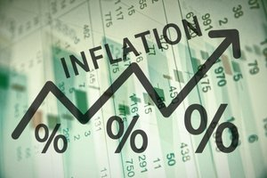
Inflation, How It's Measured and Managed
Inflation reduces the purchasing power of each unit of currency, which leads to increases in the prices of goods and services over time. It's an economics term that means you have to spend more to fill your gas tank, buy a gallon of milk, or get a haircut over time—in other words, it increases your cost of living.
U.S. inflation has reduced the value of the dollar. Compare the dollar's value today with that in the past. So as prices rise, your money buys less. For that reason, it can reduce your standard of living over time.
That's why President Reagan said, "Inflation is as violent as a mugger, as frightening as an armed robber, and as deadly as a hit man."

Slide 3
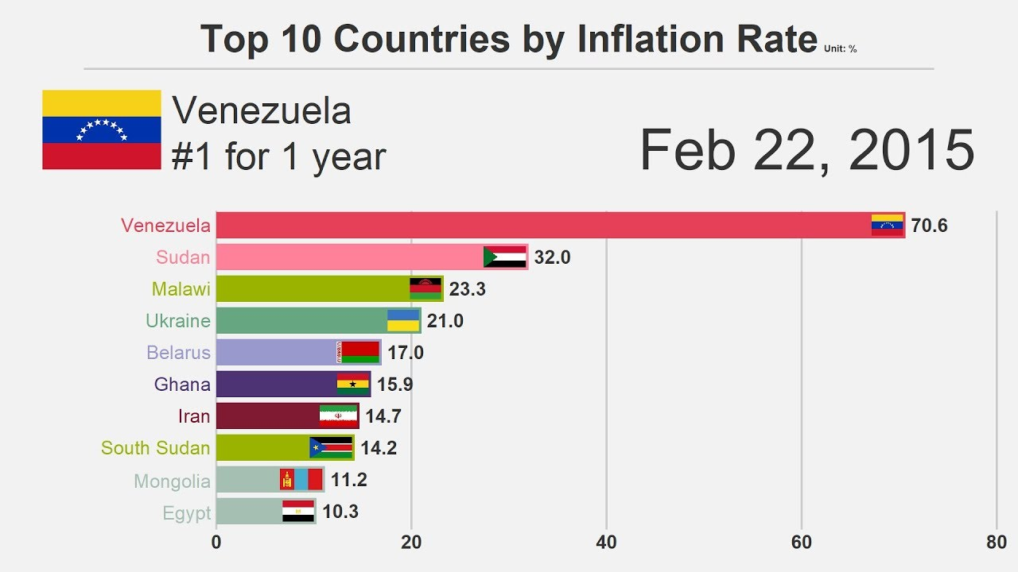
Inflation Rate
The inflation rate is the percentage increase or decrease in prices during a specified period, usually a month or a year. The percentage tells you how quickly prices rose during the period. For example, if the inflation rate for a gallon of gas is 2% per year, then gas prices will be 2% higher next year. That means a gallon of gas that costs $2.00 this year will cost $2.04 next year.
If the inflation rate is more than 50% in a month, that's hyperinflation. If inflation occurs at the same time as a recession, that's stagflation. Rising prices in assets like housing, gold, or stocks are called asset inflation.
The inflation rate is a critical component of the misery index, which is an economic indicator that helps to determine an average citizen's financial health. The other component is the unemployment rate. When the misery index is higher than 10%, it means people are either suffering from a recession, galloping inflation, or both.

Slide 4
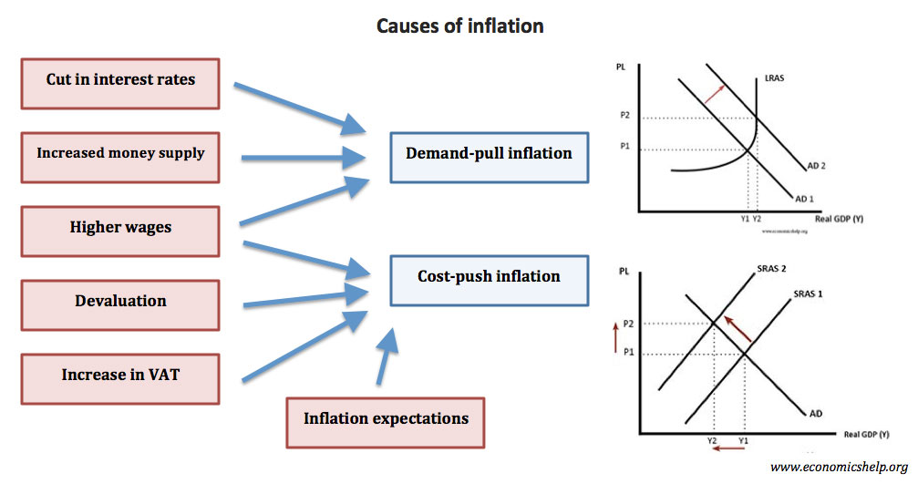
Causes
There are two causes of inflation. The most common is demand-pull inflation. That's when demand outpaces supply for goods or services. Buyers want the product so much that they're willing to pay higher prices.
Cost-push inflation is the second, less common, cause. That's when supply is restricted but demand is not. That happened after Hurricane Katrina damaged gas supply lines. Demand for gasoline didn't change, but supply constraints raised prices to $5 a gallon.
Some sources say that an increase in the money supply also causes inflation. That's a misinterpretation of the theory of monetarism. It says the primary cause of inflation is the printing out of too much money by the government. As a result, too much capital chases too few goods. It creates inflation by triggering either demand-pull or cost-push inflation.
Some also count built-in inflation as a third cause.¹﻿ This factors people’s expectations of future inflation. When prices rise, labor expects an increase in wages to keep up. But higher wages raises the cost of production, which raises prices of goods and services again. When this cause-and-effect continues, it becomes a wage-price spiral.

Slide 5

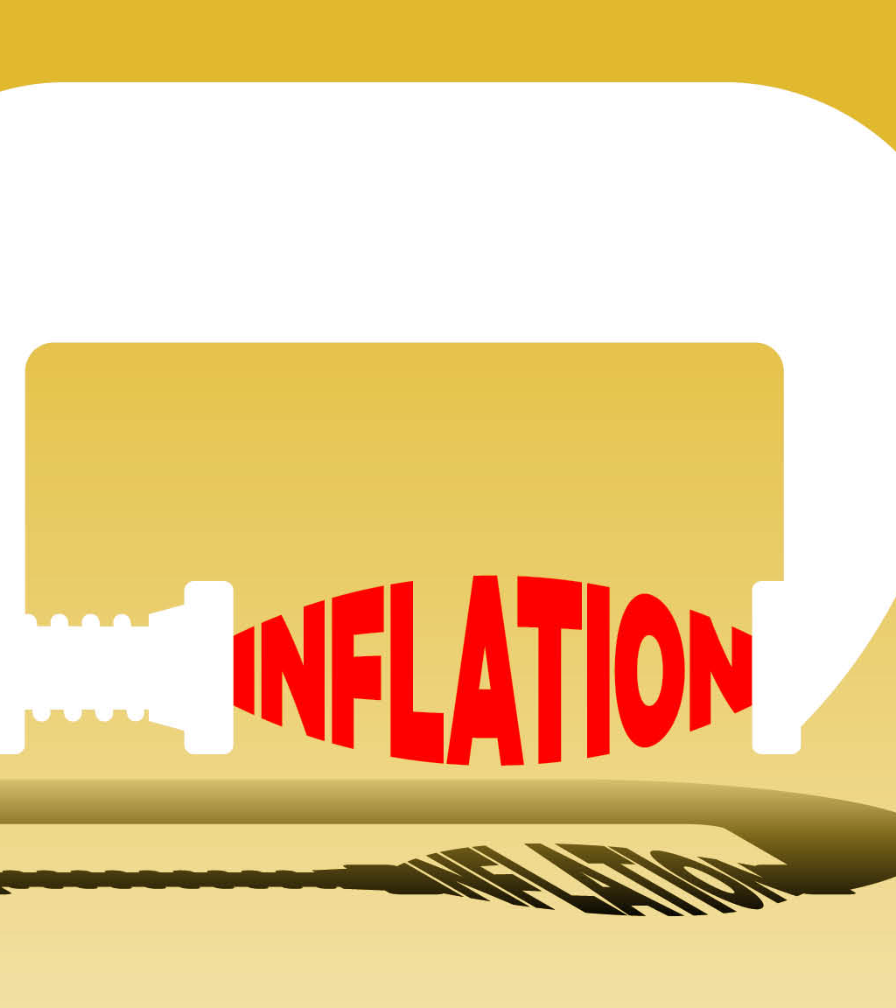
How to Protect Yourself
If you are looking for a safer way to protect yourself from inflation, consider two instruments you can purchase from the U.S. Treasury.³﻿
Treasury Inflated Protected Securities (TIPS): These pay a fixed rate of interest. Twice a year the government re-adjusts the principal in response to changes in the Consumer Price Index, as published monthly by the Bureau of Labor Statistics. This means that, as inflation increases, the value of the bond increases. Although the interest rate doesn't increase, holders get a larger cash payment because the percentage is applied to a larger principal. TIPS do well during inflation but do worse during times of non-inflation or stability. Over the long haul, they do not perform as well as a well-diversified portfolio that includes stocks.
Series I Bonds: They offer a guaranteed fixed rate of return for the life of the bond. They're also affected by a variable rate that is indexed to the CPI and is reset in November and May. The return you get for the bond is a composite of its fixed rate and the variable rate in effect at that time. To find out each bond's return, go to the Treasury Department's Savings Bond Calculator

Slide 6
The End!

